Slide 1
Water Simulation
Leftheris Kaleas

Slide 2
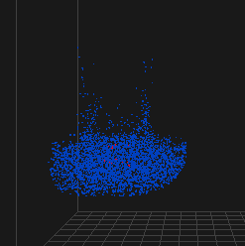
Water Simulation
Goals
To realistically simulate water and render its surface.
How?
Expand existing Fluid Sim Framework
Smoke Water.
Realistic Simulation of Water Surface
Level Sets
Surface Tracking
Marching Cubes
Mesh Extraction
Dongsoo’s Maya Plugin (OBJ Import)

Slide 3
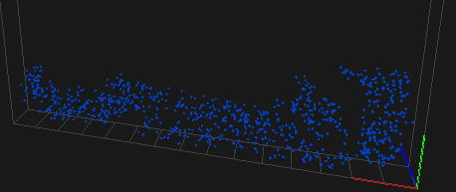

Water Simulation Approach
Strip unnecessary components
Buoyancy, Density, Temperature, etc.
Marker Particles
For visualization and tracking fluid region.
RK2 integration for advection and particle evolution.

Slide 4
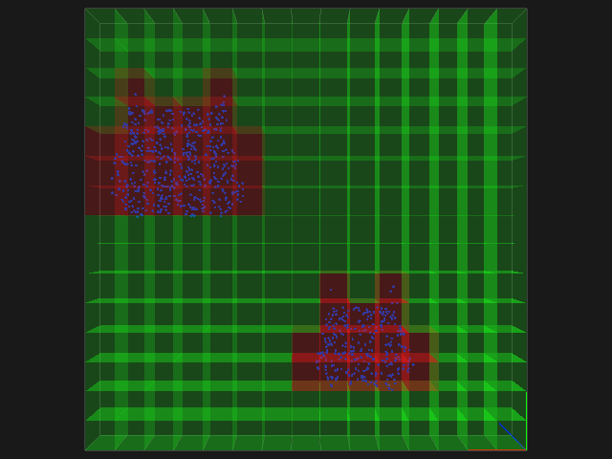
Water Simulation Approach (cont.)
Fluid/Air/Solid Cell Types
Differentiating between fluid/air/solid boundaries
Projection
Update projection to handle fluid, solid, and air cells.
Fluid Regions shown in Red
Air Regions shown in Green

Slide 5


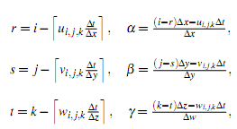
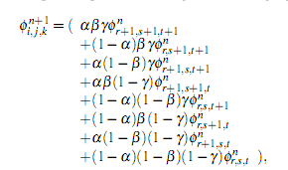
Level Sets
Initialization of Water Surface
Nearest Marker Particle Distance
Level Set Advection
Semi-Lagrangian Advection
Re-Initialization
Once Advected, Level Set will not be Signed Distance
Fast Marching to Correct

Slide 6
Velocity Extrapolation
Level Sets to find Closest Surface Point
Use Point to Extrapolate Surface Velocity into Surrounding Air Region

Slide 7
External Libraries
Built on Project 2 Framework
Referencing and Modifying:
Particle Level Set Library - Emud Mokhberi
Fast Marching Method
Marching Cubes (for Rendering Preview and OBJ Export)
Dongsoo’s AnimOBJ Plugin and Maya 2008 for Final Results

Slide 8
Implementation Details
Implementing
Water Simulation Extension
Marker Particles, Projection, External Forces, Velocity Extrapolation etc.
Level Sets
Data Structure, Initialization, Advection, Integration and Modification with Marching Cube/Fast March Library
Implementation Papers
Robert Bridson and Matthias Muller-Fischer. 2007. Fluid simulation: SIGGRAPH 2007 course notes
Fluid Flow for the Rest of Us: Tutorial of the Marker and Cell Method in Computer Graphics
Realistic Animation of Liquids: Nick Foster & Dimitri Metaxas

Slide 9
Implementation Progress
Stage 1
COMPLETED
Water Simulation using Marker Particles
OpenGL Rendering
Stage 2
COMPLETED
Water Surface using Level Sets
Semi-Lagrangian Advection
Fast Marching
Marching Cubes For Triangulation and Mesh Extraction
(However Level Sets are Dissipating Abnormally Quickly )
Stage 3
COMPLETED
Maya Rendering, OBJ Exporter (Although Marching Cubes OBJ Exporter Extension will be trivial)

Slide 10
What I Learned…
Level Sets
Algorithms
Marching Cubes
Fast Marching
Water Simulation
Marker Particles
Conclusions
Level Sets are really hard to get right.
Dissipate Easily
Extremely Difficult to Preserve Volume Through Operations.

Slide 11
RESULTS
Plan for Next Week
Plan to finish OBJ Exporter (Trivial)
Nice Looking Maya Renders
Fix Dissipation Problems in Level Set
Thank You!

